Slide 1
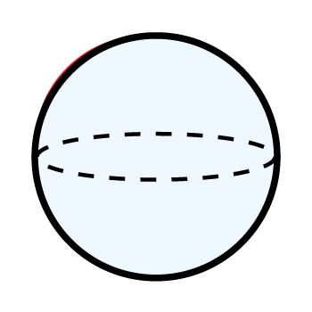
Year 3 | Week 9 | Day 1

Slide 2



Year 3 | Week 9 | Day 2

Slide 3
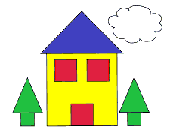
Year 3 | Week 9 | Day 3

Slide 4
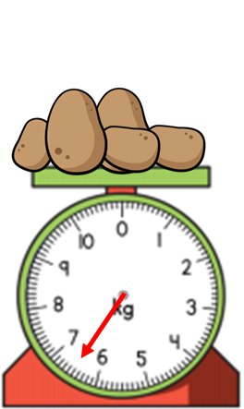

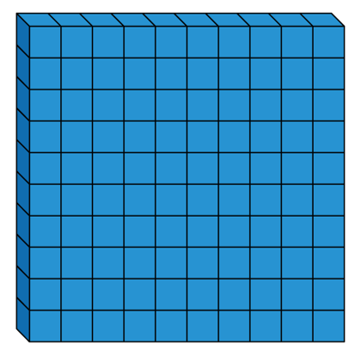

Year 3 | Week 9 | Day 4

Slide 5

Year 3 | Week 9 | Day 5
983
3
180

Slide 6
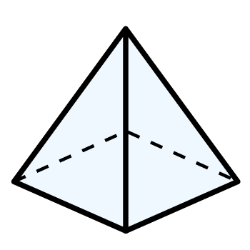
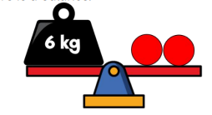

Year 3 | Week 10 | Day 1

Slide 7
Year 3 | Week 10 | Day 2

Slide 8

Year 3 | Week 10 | Day 3

Slide 9
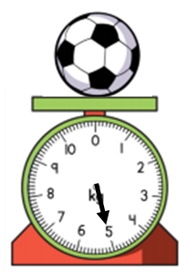
Year 3 | Week 10 | Day 4

Slide 10
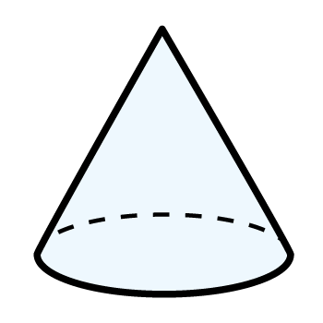
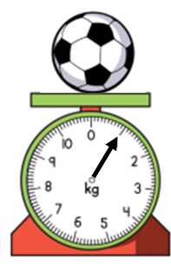
Year 3 | Week 10 | Day 5

Slide 11
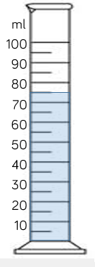
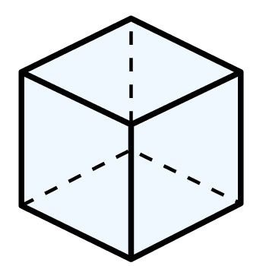
Year 3 | Week 11 | Day 1

Slide 12
Year 3 | Week 11 | Day 2

Slide 13
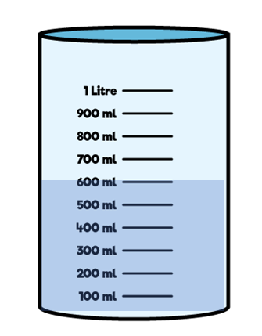
Year 3 | Week 11 | Day 3

Slide 14

Year 3 | Week 11 | Day 4

Slide 15
Year 3 | Week 11 | Day 5

